Slide 1

Early Diagnosis of Alzheimer's using the Weighted Probability Based Ensemble Method Bachelor Thesis
Name: Hamse Elmi Supervisor: Sasha Kenjeeva

Slide 2
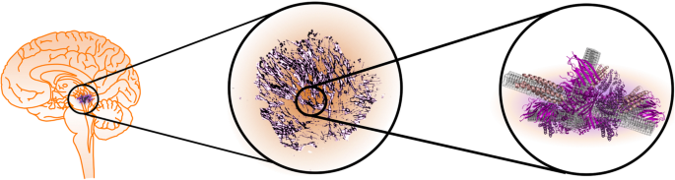
Goal of Research
Alzheimer's disease (AD): A progressive neurodegenerative disorder and leading cause of dementia globally.
Causes cognitive decline, memory loss, and functional impairments.
Impacts patients and caregivers emotionally, physically, and financially.
Early diagnosis is crucial for improving outcomes but is challenging due to subtle early symptoms and diagnostic limitations.
Role of Neuroimaging:
MRI reveals structural changes like hippocampal atrophy in later stages.
Amyloid PET detects early molecular abnormalities, such as amyloid-beta plaques, which appear before clinical symptoms.
Artificial Intelligence in Neuroimaging:
CNNs revolutionize medical image analysis but may perform inconsistently across datasets.
Ensemble learning methods like WPBEM enhance robustness by combining predictions from multiple models.
Research Question: What is the effectiveness of the Weighted Probability-Based Ensemble Method (WPBEM) compared to its individual convolutional neural network (CNN) models for the early diagnosis of Alzheimer’s disease using Amyloid PET neuroimaging data?
Notes:
Alzheimer’s disease (AD) is a progressive neurodegenerative disorder and the leading cause of dementia globally. It causes significant cognitive decline, memory loss, and functional impairments, affecting patients and caregivers emotionally, physically, and financially. With a growing aging population, early diagnosis is critical for slowing disease progression and improving outcomes, but it remains challenging due to subtle early symptoms and current diagnostic limitations.
Neuroimaging plays a vital role in AD research. While MRI reveals structural changes like hippocampal atrophy in later stages, Amyloid PET imaging detects early molecular abnormalities, such as amyloid-beta plaques, which disrupt neural communication before symptoms appear. Artificial intelligence, particularly convolutional neural networks (CNNs), has revolutionized neuroimaging analysis. However, CNNs may perform inconsistently across datasets. Ensemble learning, such as the Weighted Probability-Based Ensemble Method (WPBEM), offers a more robust approach by combining predictions from multiple models.
This thesis asks: What is the effectiveness of the Weighted Probability-Based Ensemble
Method (WPBEM) compared to its individual convolutional neural
network (CNN) models for the early diagnosis of Alzheimer’s disease
using Amyloid PET neuroimaging data?

Slide 3
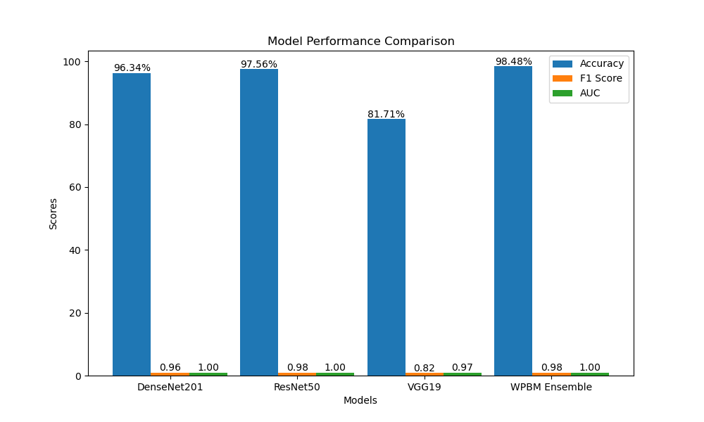
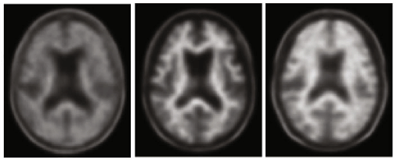
Results of Research
Objective: Evaluate the Weighted Probability-Based Ensemble Method (WPBEM) for classifying Alzheimer’s Disease (AD), Mild Cognitive Impairment (MCI), and Normal Cognition (NC) using Amyloid PET data from the ADNI3 dataset.
Approach:
Combined predictions of three CNNs (DenseNet201, ResNet50, VGG19) to improve diagnostic accuracy.
Preprocessed PET data and optimized model configurations using hyper-tuning.
Evaluated performance using metrics: accuracy, F1 score, AUC, sensitivity, and specificity.
Key Findings:
WPBEM achieved 98.48% accuracy, F1 score of 0.985, sensitivity of 0.991, and specificity of 1.000.
Demonstrated superior performance, especially in distinguishing MCI from NC and AD.
Reduced false positives, improving clinical applicability and patient outcomes.
Significance:
WPBEM enhances early diagnosis of AD, supporting timely interventions and better disease management.
The framework is generalizable to other neurodegenerative diseases and multi-modal datasets.
Conclusion: WPBEM underscores the value of ensemble learning in neuroinformatics and offers potential for advancing precision medicine in early AD diagnosis.
Notes:
Alzheimer’s disease (AD) is a progressive neurodegenerative disorder and the leading cause of dementia globally. It causes significant cognitive decline, memory loss, and functional impairments, affecting patients and caregivers emotionally, physically, and financially. With a growing aging population, early diagnosis is critical for slowing disease progression and improving outcomes, but it remains challenging due to subtle early symptoms and current diagnostic limitations.
Neuroimaging plays a vital role in AD research. While MRI reveals structural changes like hippocampal atrophy in later stages, Amyloid PET imaging detects early molecular abnormalities, such as amyloid-beta plaques, which disrupt neural communication before symptoms appear. Artificial intelligence, particularly convolutional neural networks (CNNs), has revolutionized neuroimaging analysis. However, CNNs may perform inconsistently across datasets. Ensemble learning, such as the Weighted Probability-Based Ensemble Method (WPBEM), offers a more robust approach by combining predictions from multiple models.
This thesis asks: What is the effectiveness of the Weighted Probability-Based Ensemble
Method (WPBEM) compared to its individual convolutional neural
network (CNN) models for the early diagnosis of Alzheimer’s disease
using Amyloid PET neuroimaging data?

